Slide 1
KNN - Definition
KNN is a simple algorithm that stores
all available cases and classifies new
cases based on a similarity measure
1

Slide 2
KNN – different names
K-Nearest Neighbors
Memory-Based Reasoning
Example-Based Reasoning
Instance-Based Learning
Case-Based Reasoning
Lazy Learning

Slide 3
KNN – Short History
Nearest Neighbors have been used in statistical estimation and pattern recognition already in the beginning of 1970’s (non-parametric techniques).
Dynamic Memory: A theory of Reminding and Learning in Computer and People (Schank, 1982).
People reason by remembering and learn by doing.
Thinking is reminding, making analogies.
Examples = Concepts???

Slide 4
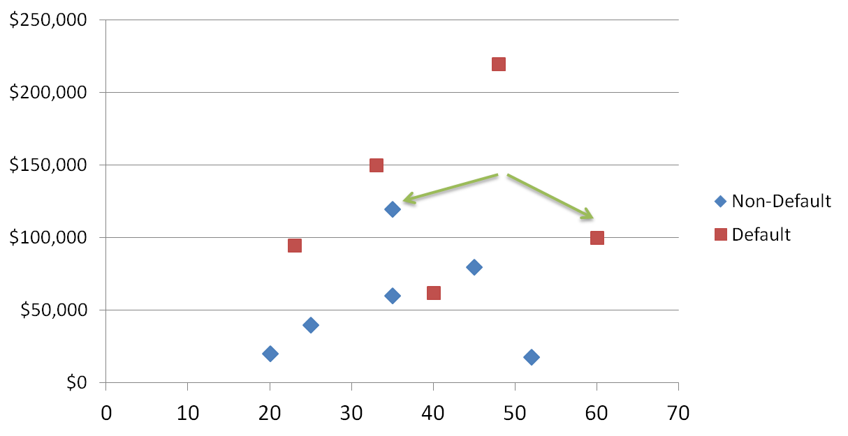

KNN Classification
Loan$
Age

Slide 5

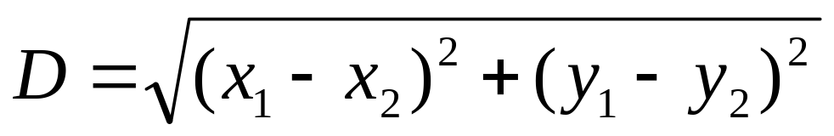
KNN Classification – Distance
Age | Loan | Default | Distance
25 | $40,000 | N | 102000
35 | $60,000 | N | 82000
45 | $80,000 | N | 62000
20 | $20,000 | N | 122000
35 | $120,000 | N | 22000
52 | $18,000 | N | 124000
23 | $95,000 | Y | 47000
40 | $62,000 | Y | 80000
60 | $100,000 | Y | 42000
48 | $220,000 | Y | 78000
33 | $150,000 | Y | 8000
48 | $142,000 | ?
Euclidean Distance

Slide 6

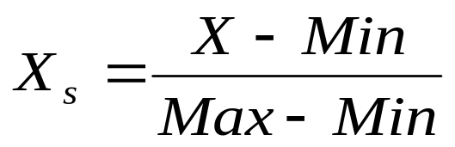
KNN Classification – Standardized Distance
Age | Loan | Default | Distance
0.125 | 0.11 | N | 0.7652
0.375 | 0.21 | N | 0.5200
0.625 | 0.31 | N | 0.3160
0 | 0.01 | N | 0.9245
0.375 | 0.50 | N | 0.3428
0.8 | 0.00 | N | 0.6220
0.075 | 0.38 | Y | 0.6669
0.5 | 0.22 | Y | 0.4437
1 | 0.41 | Y | 0.3650
0.7 | 1.00 | Y | 0.3861
0.325 | 0.65 | Y | 0.3771
0.7 | 0.61 | ?
Standardized Variable

Slide 7
KNN Regression - Distance
Age | Loan | House Price Index | Distance
25 | $40,000 | 135 | 102000
35 | $60,000 | 256 | 82000
45 | $80,000 | 231 | 62000
20 | $20,000 | 267 | 122000
35 | $120,000 | 139 | 22000
52 | $18,000 | 150 | 124000
23 | $95,000 | 127 | 47000
40 | $62,000 | 216 | 80000
60 | $100,000 | 139 | 42000
48 | $220,000 | 250 | 78000
33 | $150,000 | 264 | 8000
48 | $142,000 | ?

Slide 8
KNN Regression – Standardized Distance
Age | Loan | House Price Index | Distance
0.125 | 0.11 | 135 | 0.7652
0.375 | 0.21 | 256 | 0.5200
0.625 | 0.31 | 231 | 0.3160
0 | 0.01 | 267 | 0.9245
0.375 | 0.50 | 139 | 0.3428
0.8 | 0.00 | 150 | 0.6220
0.075 | 0.38 | 127 | 0.6669
0.5 | 0.22 | 216 | 0.4437
1 | 0.41 | 139 | 0.3650
0.7 | 1.00 | 250 | 0.3861
0.325 | 0.65 | 264 | 0.3771
0.7 | 0.61 | ?

Slide 9
KNN – Number of Neighbors
If K=1, select the nearest neighbor
If K>1,
  For classification select the most frequent neighbor.
  For regression calculate the average of K neighbors.

Slide 10
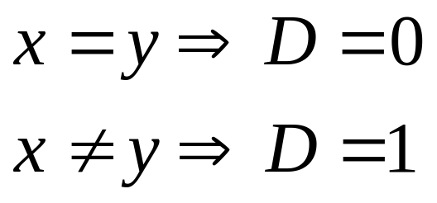
Distance – Categorical Variables
X | Y | Distance
Male | Male | 0
Male | Female | 1

Slide 11
Instance Based Reasoning
IB1 is based on the standard KNN
IB2 is incremental KNN learner that only incorporates misclassified instances into the classifier.
IB3 discards instances that do not perform well by keeping success records.

Slide 12
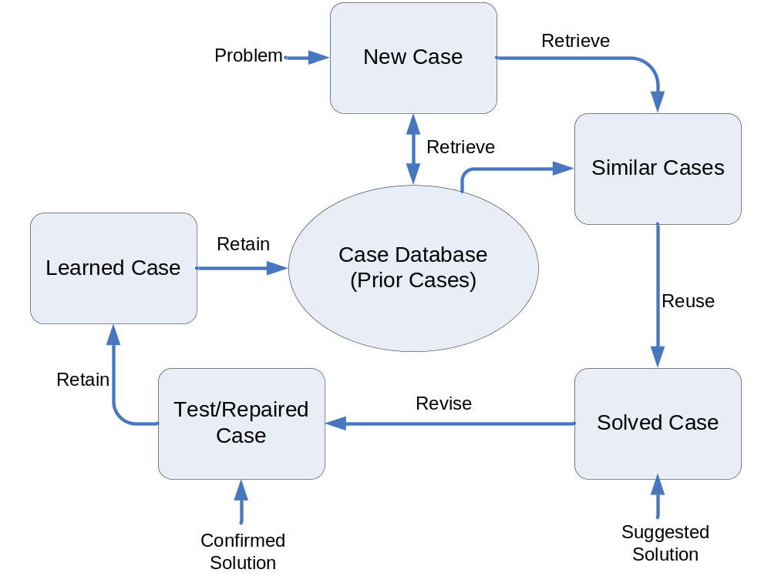
Case Based Reasoning

Slide 13
KNN - Applications
Classification and Interpretation
  legal, medical, news, banking
Problem-solving
  planning, pronunciation
Function learning
  dynamic control
Teaching and aiding
  help desk, user training

Slide 14
Summary
KNN is conceptually simple, yet able to solve complex problems
Can work with relatively little information
Learning is simple (no learning at all!)
Memory and CPU cost
Feature selection problem
Sensitive to representation

